Slide 1
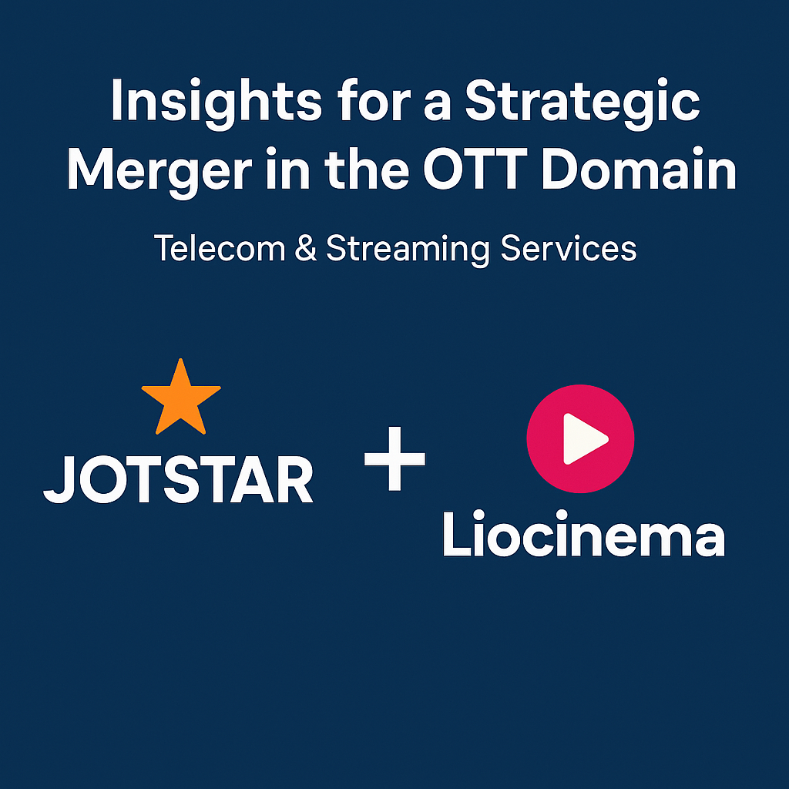


Slide 2

Table of Content
Overview
Goals
Primary Research Questions
Secondary Research Questions & Recommendations

Slide 3
Overview
LioCinema: Strong subscriber base, backed by Lio’s telecom ecosystem.
Jotstar: Extensive and diverse content library with high engagement levels.
Merger Synergy: Creating a powerhouse in India’s OTT landscape by leveraging strengths from both platforms.

Slide 4
Goals
Content Library Analysis
Subscriber Analysis
Inactivity Analysis
Upgrade / Downgrade Patterns
Content Consumption Behavior (Watch Time Analysis)
Revenue Analysis

Slide 5
a
Primary Research Question
Domain: Transportation & Mobility

Slide 6
Subscribers Analysis : Total Users & Monthly growth rate
Platform | Users | Avg Monthly Growth Rate
Jotstar | 44.6k | 0.81%
Liocinema | 183k | 18.6%

Slide 7
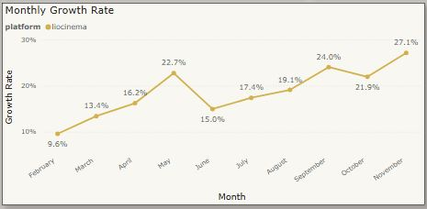
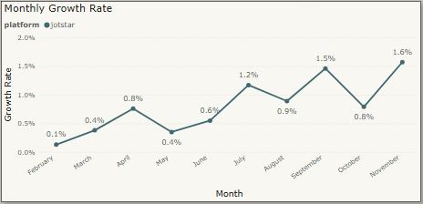
Subscribers Analysis : Monthly Trend

Slide 8
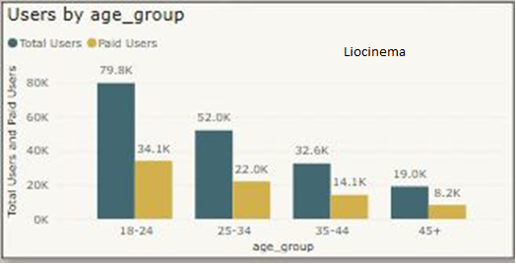
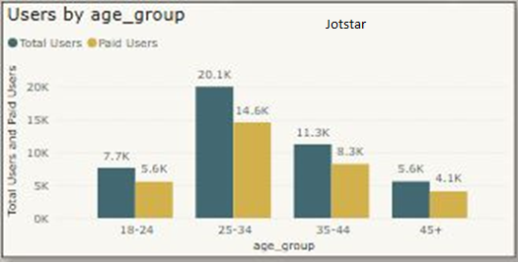
Subscribers Analysis : Users by Age Group

Slide 9
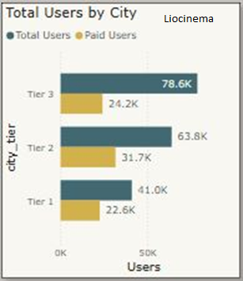
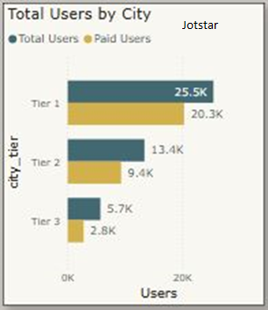
Subscribers Analysis : User by City

Slide 10
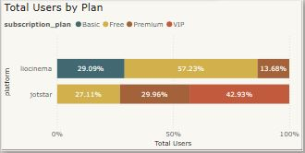
Subscribers Analysis : User by Plan

Slide 11
Subscribers Analysis : Active vs. Inactive Rate
Platform | Active | Inactive
Jotstar | 85% | 15%
Liocinema | 55% | 45%

Slide 12
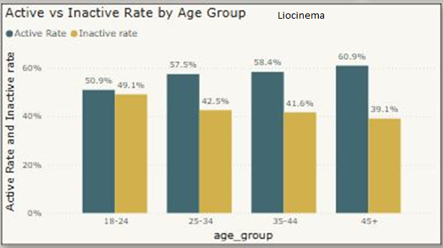
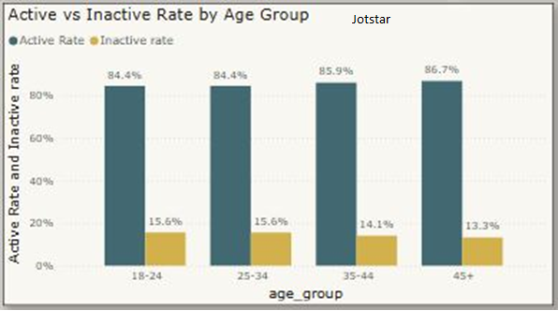
Subscribers Analysis : Active vs. Inactive Rate by Age

Slide 13
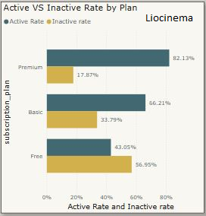
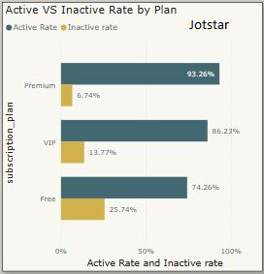
Subscribers Analysis: Active VS Inactive Rate by Plan

Slide 14
Subscribers Analysis : Paid Users Distribution
Platform | Paid Users | Paid %
Jotstar | 33k | 72%
Liocinema | 78k | 43%

Slide 15
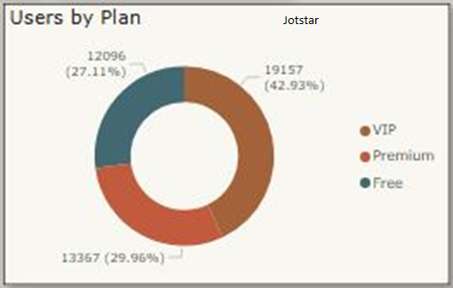
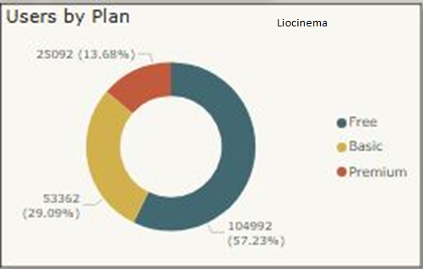
Subscribers Analysis: Users by Plan

Slide 16
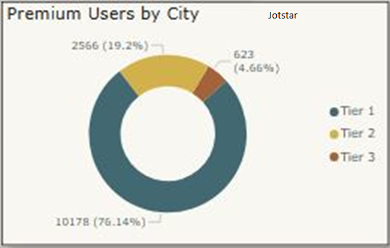
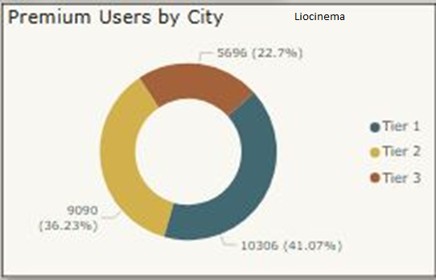
Subscribers Analysis : Premium Users by City

Slide 17
Content Library Analysis: Content & Language Count
Platform | Content | Language
Jotstar | 2360 | 10
Liocinema | 1250 | 7

Slide 18
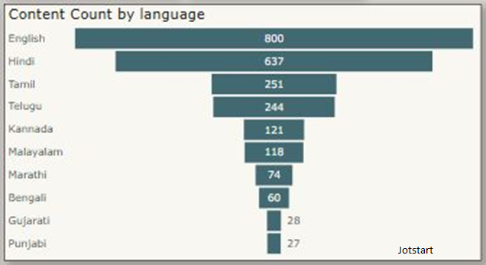
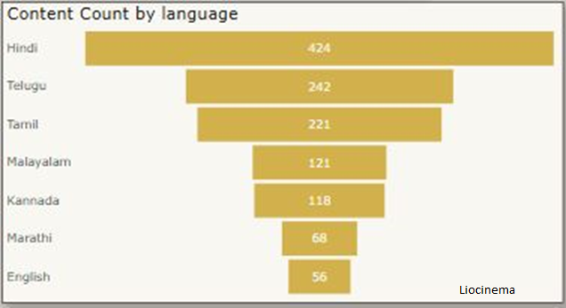
Content Library Analysis: Content Count by Language

Slide 19
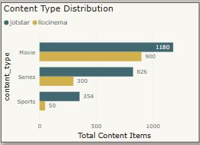
Content Library Analysis: Content type Distribution

Slide 20
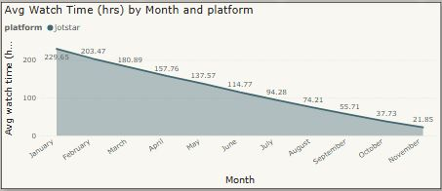
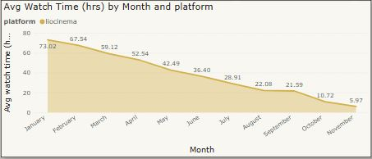
Watch Time Analysis: Monthly Trend
Insight :
Jotstar – 117 hr average watch time
Liocinema – 25.6 hr average watch time

Slide 21
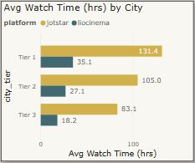
Watch Time Analysis: Avg Watch Time by City

Slide 22
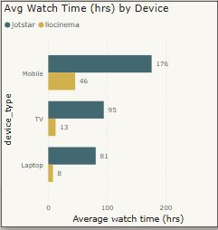
Watch Time Analysis: Avg Watch Time by Device

Slide 23
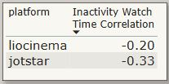
Inactivity Analysis: Correlation
Insight :
A negative correlation indicates that lower watch time is linked to higher inactivity.

Slide 24
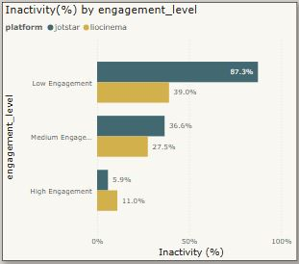
Inactivity Analysis: Inactivity Rate by Engagement Level

Slide 25
Downgrade Analysis: User & Percentage
Platform | Downgrade Count | Downgrade Rate
Jotstar | 2742 | 6.15%
Liocinema | 20.8k | 11.3%

Slide 26
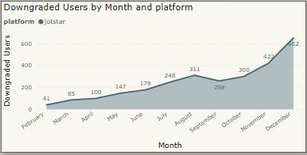
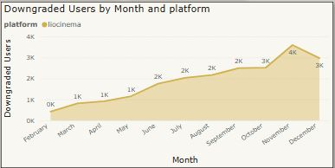
Downgrade Trends

Slide 27
Upgrade Analysis: Count & Percentage
Platform | Upgrade Count | Upgrade Rate
Jotstar | 4348 | 9.7%
Liocinema | 4155 | 2.3%

Slide 28
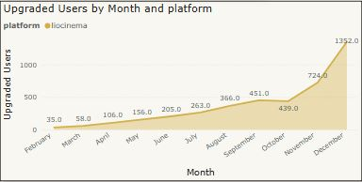
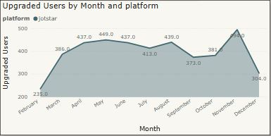
Upgrade Monthly Trend

Slide 29
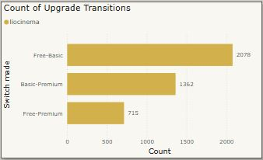
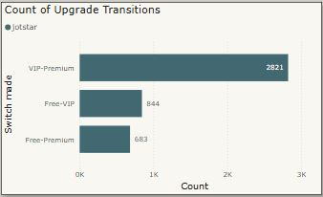
Upgrade Patterns

Slide 30
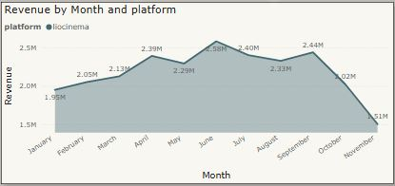
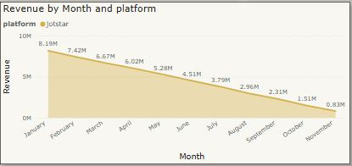
Revenue Analysis: Monthly Trend
Insight :
Jotstar – 49M
Liocinema – 24M

Slide 31
a
Secondary Research Question

Slide 32
a
1. Convert inactive users into active users.
✔ Personalized Recommendations: AI-driven content suggestions based on past viewing history.
✔ Push Notifications & Email Campaigns: Highlight trending shows, unfinished content, and exclusive releases.
✔ Gamification & Loyalty Rewards: Introduce watch streaks, badges, or points redeemable for discounts.
✔ Exclusive Free Content & Limited-Time Offers: Offer free episodes or discounted subscriptions for inactive users.
✔ Survey & Feedback Loops: Gather insights on why users become inactive and tailor content strategies accordingly.

Slide 33
a
2. Position the merged platform as India's go-to OTT destination.
✔ Regional Content Expansion: Focus on Tier 2 & 3 cities with vernacular content.
✔ Bollywood & Cricket Collaborations: Partner with top production houses and sports leagues.
✔ AI-Powered Content Marketing: Dynamic ad placements based on user interests.
✔ Celebrity-Driven Digital Campaigns: Leverage Bollywood, cricket, and influencer marketing.

Slide 34
a
3. Competitive pricing while ensuring sustainable revenue.
✔ Freemium Model: Free content with ads, premium ad-free experience.
✔ Segmented Pricing:
Basic: Affordable, mobile-only.
Standard: HD streaming, multi-device.
Premium: Ultra HD, family sharing, exclusive premieres.
✔ Introductory Discounts & Bundled Plans: Offer discounts for annual plans or first-time subscribers.
✔ "Pay Per View" Model for Blockbusters: Monetize premium movie releases separately.

Slide 35
a
4. Expand the subscriber base through telecom integrations.
✔ Bundle OTT Subscription with Mobile Plans: Collaborate with Jio, Airtel, Vi for free streaming on higher-tier plans.
✔ Data-Free Streaming: Zero-rated streaming to encourage usage.
✔ Preloaded OTT App on Smart Devices: Partner with smartphone and smart TV brands.
✔ 5G Content Optimization: Offer exclusive low-latency, high-definition content for 5G users.

Slide 36
a
5. Enhance user experience & retention.
✔ AI-Driven Content Recommendations: Personalized suggestions based on user behavior.
✔ Smart Search & Voice Assistants: AI-powered search for quick content discovery.
✔ Automated Subtitles & Dubbing: Expand regional reach using AI-driven translations.
✔ Dynamic Pricing & Offers: Personalized discounts based on user engagement.
✔ Sentiment Analysis for Content Strategy: Use NLP on user reviews to shape content production.

Slide 37
Thank You

